Slide 1
6th Grade Orientation
Online Learning Option
Welcome to Butler Middle School!

Slide 2
Chromebooks
If you have not picked up your chromebook and class materials, please call the main office at (801) 826-6800 to schedule a time for pick up.
You also could pick up your chromebook and class materials after orientation this morning. They are in the Main Office.

Slide 3
How to Read Your Schedule/ Bell Schedule and Tour
1st Period

Slide 4
Your Schedule
A/B Schedules
On A days we have periods 1A-6A and on B days we have periods 1B-6B.
On your schedule there is an “A day” column and a “B day” column.
Online students--this will apply to your electives classes.

Slide 5
Your Schedule
You will have work to do in your core classes EVERY day on Canvas!
Math
Science
Social Studies
Language Arts

Slide 6
Your Schedule
You will meet with your teacher at scheduled times that you will be invited to.
These sessions will be recorded so if you are ill or miss one, you are expected to watch the recording.

Slide 7
Your Schedule
Your Schedule has a lot of useful information
Teacher’s Name
Name of Class
Room Numbers

Slide 8
Your Day
There is work to complete for each class, every day.
You will complete one module each week in Canvas in each subject area. Each module should take about 3-4 hours.
Your teacher will be watching your progress through these modules and will be available to help each day at the assigned class time.
Keep a consistent daily schedule to help yourself be a successful Bruin!

Slide 9
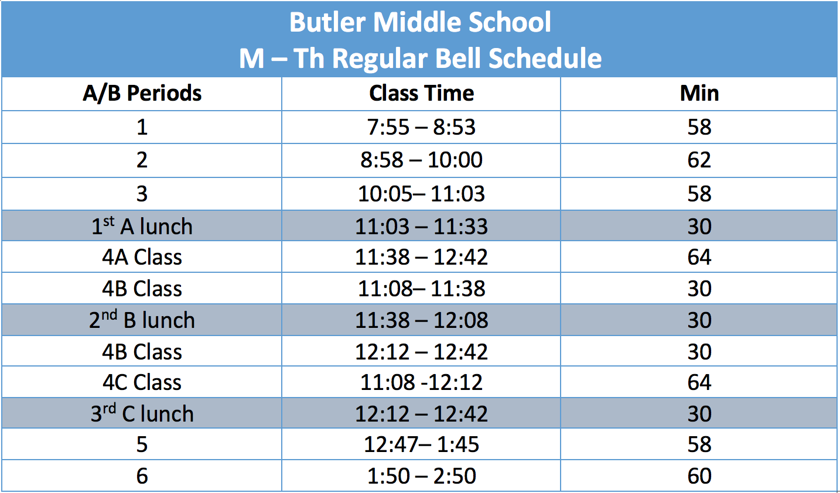
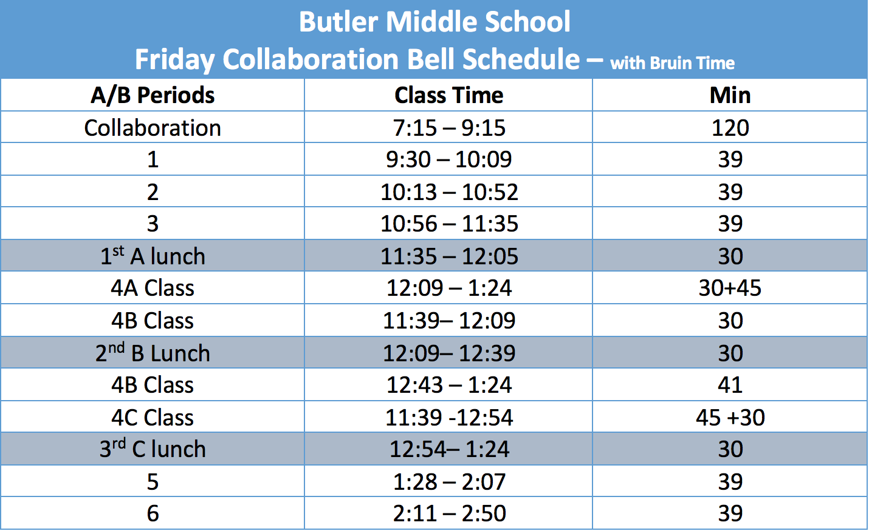
Bell Schedules – Inside Cover of Planner
Monday - Thursday
Friday
Please glue a corrected bell schedule into your student planner
on the inside cover.
6th Grade Students have C Lunch

Slide 10
Tour
We will be taking a tour of the building so you know what other services are available to you at Butler Middle

Slide 11
Planners, Offices, Media Center, Dress Code and Lunch Options
2nd Period

Slide 12
Your Planner
Students: You received your planner with the chromebook and additional materials, please write on the first page of your planner :
Name
Grade
Team
Schedule
Turn to page 1 - Planner Contract.
Read and sign the contract.
Turn to page 17
Write your full name and grade on the bottom of this page.
Notes:
Teachers can model this. Many student may not have their planner as we did not ask them to bring it. You may want to project the picture of the page.

Slide 13
Your Planner
Your planner is useful for keeping track of homework, assignments, and projects.
Look on page 16 of your planner. You will see a month calendar which includes important school dates.
Look on page 18-19. Here you will write down daily objectives, assignments, and their due date.
Look at the bottom of page 19. This is where you need to write any missing assignments you have for the week.

Slide 14
Your Planner
If you lose your planner a replacement will cost you $3.00.
Students will receive a new planner at the beginning of each semester.

Slide 15
Counseling Center
The Counseling Center is located near the main entrance across from the Main Office.
Our counselors, school psychologist, and social workers are all located in the counseling center.
Our counselors assist you with:
Planning your schedule
Emotional concerns
Guidance for career choices
College preparation
Assistance with social issues such as relationships with peers and teachers
Study skills
Ms.Tatiana Grant
School Counselor (M-Z)
Ms Heindel
School Counselor (A-L)
Ms. Ferreira
School Social Worker

Slide 16
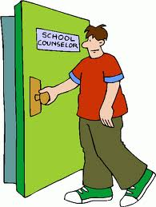
Counseling Center
You need to make an appointment to see the people in the Counseling Center. Make an appointment using the Request For Appointment Form found on the school website or Counseling Center Canvas page.
Ms. Carolann Heindel( A-L) - Counselor
Ms. Tatiana Grant (M-Z) - Counselor
Ms. Epperson- Psychologist
Ms. Ferreira – Social Worker

Slide 17
Main Office
The Main Office is located near the front entrance. They assist you with:
School fines or fees
Paying for your lunch
Paying for memory books
Replacing planners and ID badges
No money will be accepted after 2:00 PM
Ms. Vicki
Attendance Secretary
Ms. Ladena
Head Administrative Assistant
Ms. Tami
Hall Monitor
Ms. Stephanie
Educational Support

Slide 18
Media Center
Library books will be available through an online catalogue. More information will be emailed to online students or through your ELA class.
Books will be available for pick up in the main office.
All library services will be available either digitally or through special arrangement with the librarian.
Mrs. Jen VanHaaften
Teacher Librarian

Slide 19
Dress Code
Turn to pages 11-12 of your planner.
Review the dress code.
Please be aware that all students in Canyons School District must follow this same dress code.
Remember: Dress code still applies when you are visible to other school members online.
Face coverings ARE required while at school.

Slide 20
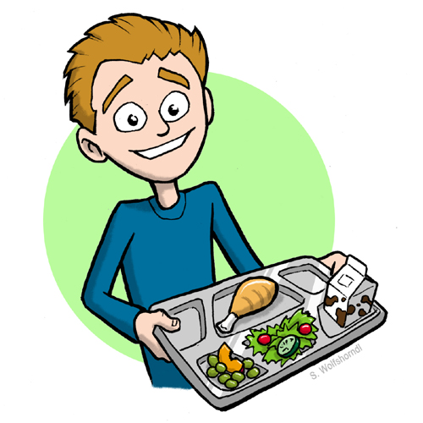
Grab and Go Meals
Breakfast and Lunches will be available for online students.
There is a process for Grab and Go meals.
You will need to email dawn.butcher@canyonsdistrict.org to order a Grab and Go Meal before 9 AM in the morning.
Your meals will then be available for pick up between 10:15 - 10:45 each day at the front of the building
You will need your student ID number to pick up the meal which will be just inside the front doors. PICK UP IS BETWEEN 10:15 – 10:45

Slide 21
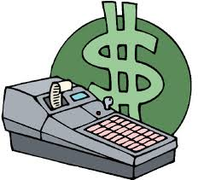
Grab and Go Meals
You can apply for free or reduced lunch benefits in the main office.
Breakfast cost is $1.25
Lunch cost is $2.25
Reduced cost is $0.30
Reduced cost is $0.40
Free includes breakfast and lunch
Adult lunch or second child lunch is $3.75
Lunch money must be deposited in the main office before 10:15 AM to be available for lunch that day.
You can also pay through the online PayPams
Menu
Breakfast Menu:
cereal, fruit, and milk
Lunch Menu:
Monday – Mini Corn Dog
Tuesday – PBJ
Wednesday – Hamburger
Thursday – Pizza
Friday – Turkey Deli

Slide 22
Terminology
3rd period

Slide 23
Term Grades
All final grades are tracked online using a program called Skyward. A username and password will be provided for you.
Individual practice / assessment grades will be found on Canvas
You will earn a final grade at the end of each quarter. There are four quarters.
Report cards are not printed and sent home. Your final grades will be posted online for you to view on Skyward.

Slide 24
Midterm Reports
An email will be sent to your parents once per quarter to indicate your current grades and missing assignments.
Your teacher may also email you missing assignment reminders from Canvas throughout each quarter.
This is not your final grade. It is to let you and your parents know of your progress in each of your classes up to that date.
Grade information is always available for you or your parents on Skyward.

Slide 25
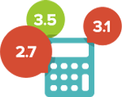
GPA
Grade Point Average (GPA)
A=4.0
B=3.0
C=2.0
D=1.0
F=0.0

Slide 26
Honor Roll
A list of Honor Roll students will be posted each term.
To qualify, a student must earn a 3.5 GPA.

Slide 27
NJHS
NJHS stands for National Junior Honors Society
Primarily a service organization
In order to be a member you must maintain a 3.6 cumulative GPA

Slide 28
Citizenship
Citizenship is a grade assigned to students for behavior and character.
H = Honors
S = Satisfactory
N = Needs Improvement
U = Unsatisfactory
Turn to page 13 in your planner.
Glue in the updated Citizenship Rubric and then review it.

Slide 29
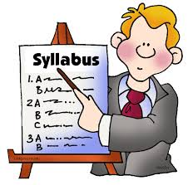
Disclosure Statement
Classroom Document produced by each of your teachers that explains their classroom rules and expectations.

Slide 30
Digital Citizenship as a GREAT Bruin
4th period

Slide 31
PBIS Matrix
Please turn to page 74 in your planner.
Review GREAT Bruin expectations.

Slide 32
GREAT Bruins
Good Citizens
Respectful
Engage
Always safe
Totally Responsible

Slide 33
Good Citizens
GREAT Bruins are Good Citizens
Remember to use academic and appropriate language at all school scheduled times.
Report anything you see that makes you feel uncomfortable or inappropriate, during your online learning, to your teacher.

Slide 34
Respectful
GREAT Bruins are Respectful
Be positive when collaborating digitally
Be on time to your Google Meet times
Be kind in your messaging/chat with other school members
Respect other student’s ideas.
We all learn best when we work together!

Slide 35
Engaged
GREAT Bruins are Engaged
Only visit approved internet sites (Canvas, Skyward, etc.) on your district provided chromebook.
Participate appropriately with your online learning. This looks like:
Muting the microphone when you are not speaking
Use chat features to ask questions to the teacher
Minimize distraction as best as you can
Remember if your camera is on, others can see you

Slide 36
Always Safe
GREAT Bruins are Always Safe
Hold your computer with both hands while walking
Your computer should be shut when walking
Never give out personal information including login

Slide 37
Totally Responsible
GREAT Bruins are Totally Responsible
Keep your chromebook charged and ready to use
Keep food and drink away from your device.

Slide 38
Check in
If you still need your chromebook and online materials please go to the main office and pick these up.
Any questions?

Slide 39
Dismissal
Welcome to Butler Middle School!
It is going to be a GREAT year.

